Slide 1
Study on Smoke and Fire Spread in Tunnel Fires
Name: | Tengteng Li
Supervisor: | Prof. Lukas Arnold & Prof. Bing Wu
University: | University of Wuppertal & China University of Mining and Technology-Beijing
Date: | 24.11.2021

Slide 2
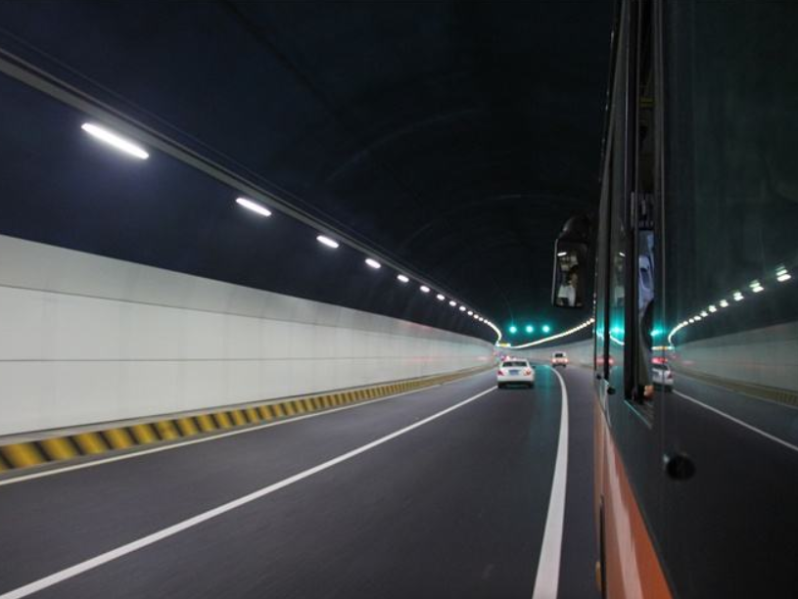
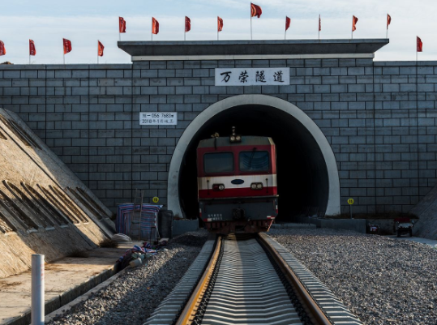
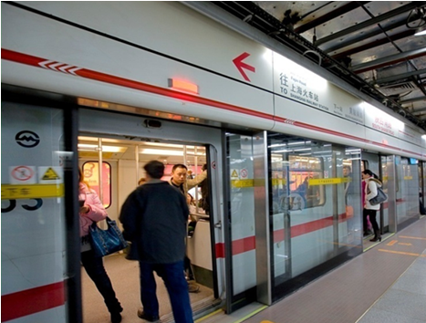
1. Background
Development of tunnel
As an important means to relieve traffic pressure and promote cargo transportation, a large number of different forms of tunnel systems came into being.
Take China as an example, over the past decade, the number of highway tunnels in China has increased by more than 1000 every year. In 2021, about 2000 railway tunnels are expected to be built. By 2020, 44 cities have been approved for subway tunnel planning. There will be more tunnel projects in the future.
Highway tunnel
Railway tunnel
Subway tunnel

Slide 3
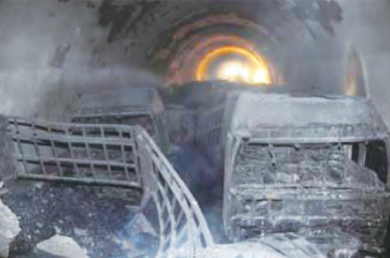
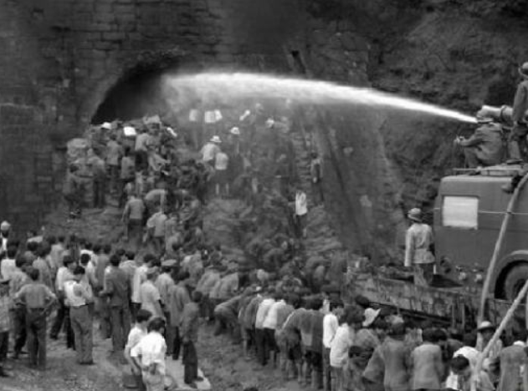
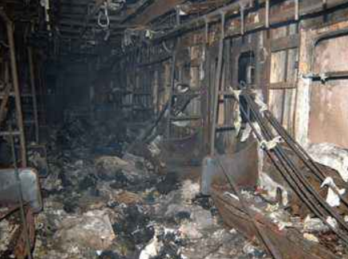
1. Background
Occurrence of tunnel fire
While the tunnel has brought us more convenience and benefits, the number of tunnel fire accidents has also increased rapidly.
Due to the special long and narrow structure of the tunnel, the heat and toxic smoke cannot be directly discharged outside after a fire, which may cause serious casualties and property losses.

Slide 4
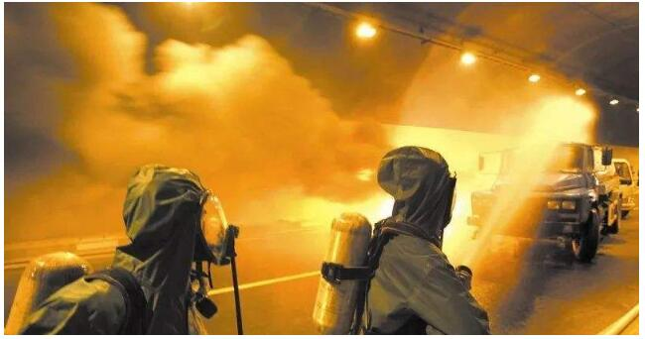
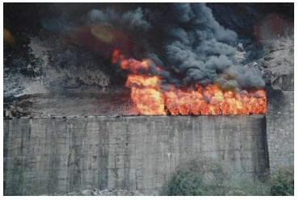
1. Background
Characteristics of tunnel fire
Heavy smoke and high temperature. In case of fire in the tunnel, due to the small tunnel space and closed state, the flue gas is not easy to be discharged and the heat generated by combustion is not easy to be dissipated; The fire may damage the tunnel lighting system and low visibility, which makes it difficult to put out the fire and evacuate people.
Evacuation difficulty. The tunnel cross section is small and the road is narrow. In addition to the difficulty of personnel evacuation, material evacuation is also extremely difficult in case of fire.
Fire fighting difficulty. In case of fire in the tunnel, the fire rescue road is narrow, and it is difficult for firefighters to get close to the fire source to put out the fire.

Slide 5
2. Research status and hot topics
Hot keywords
method
contents
factor
1. Temperature distribution law of ceiling flue gas
_{1. shape}
_{Experiment}
_{2. gradient}
2. Countercurrent length of flue gas
_{3. length}
_{Theory}
3. Critical longitudinal ventilation velocity
_{4. traffic jam}
_{4. Exhaust}
_{5. fire location}
_{Numerical Simulation}
_{6. fire type}
_{5. Fire spread}
_{7. atmosphere}
_{6. Fire control}
_{8. oxygen}

Slide 6
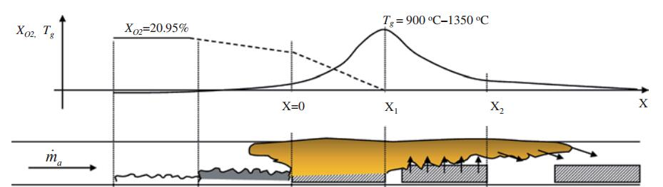
2. Research status and hot topics
Temperature distribution law of ceiling flue gas
The law of maximum flue gas temperature rise and longitudinal temperature rise under the roof is one of the most important parameters to evaluate tunnel fire risk and guide fire detection.
The strength of most concrete in the tunnel will decrease when the temperature exceeds 300 ℃; When the temperature reaches 250-420 ℃, the concrete surface falls off.
In full-scale tunnel fire, when the flame strikes the ceiling to form ceiling jet flame, the maximum ceiling temperature reaches 1350 ℃.

Slide 7
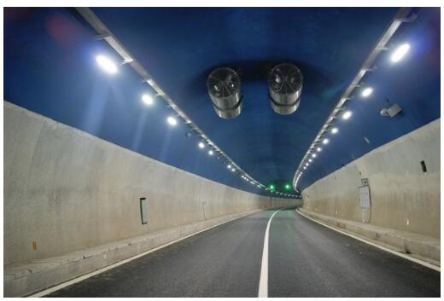
2. Research status and hot topics
Counterflow length of flue gas
Longitudinal ventilation is the main ventilation and smoke exhaust mode in the tunnel.
Longitudinal ventilation can provide a relatively smoke-free area for upstream personnel or vehicles.
The counterflow length of flue gas is the distance from the flue gas to the upstream of the fire source.

Slide 8
2. Research status and hot topics
Critical longitudinal ventilation velocity
The critical ventilation speed is the ventilation speed when the flue gas counterflow length is 0m.
A large number of theoretical research and practical results have shown that the longitudinal ventilation speed of 3m/s can inhibit the spread of fire smoke under all heat release rates.

Slide 9
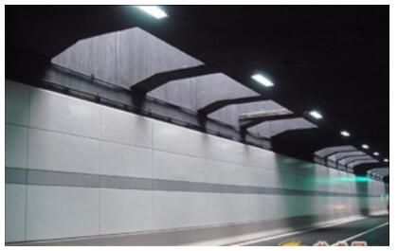
2. Research status and hot topics
Smoke exhaust
Longitudinal ventilation will destroy the structure of downstream flue gas and increase the risk of downstream fire.
Natural ventilation (transverse ventilation and smoke exhaust system) is a widely used ventilation and smoke exhaust method at this stage, which mainly uses the stack effect of smoke outlet or shaft to exhaust smoke.
Natural ventilation has the advantages of energy saving, low operation cost, no occupation of tunnel space and no damage to the downstream flue gas layer structure.
The smoke exhaust capacity is mainly related to the opening size, height, layout spacing and other factors of the shaft.

Slide 10
2. Research status and hot topics
Spread of fire
Under limited conditions, the ceiling flame jet will be formed longitudinally after the flame strikes the ceiling. The flame length determines whether the fire will ignite adjacent combustible objects.

Slide 11
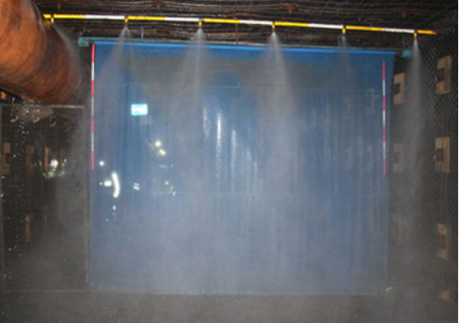
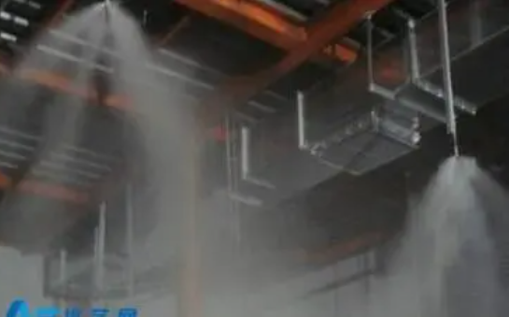
2. Research status and hot topics
Fire fighting
High pressure water mist fire extinguishing system, using pure water as a fire extinguishing medium, uses a special sprinkler to decompose water into small water droplets under specific pressure (usually 10MPa) to extinguish a fixed fire extinguishing system.

Slide 12
3. Research proposal
Research Tools
FDS | Fire Dynamics Simulator (FDS), is a computational fluid dynamics (CFD) model of fire-driven fluid flow. FDS solves numerically a form of the Navier-Stokes equations appropriate for low-speed (Ma < 0.3), thermally-driven flow with an emphasis on smoke and heat transport from fires.
Smokeview | Smokeview is a scientific software tool designed for visualizing numerical predictions generated by fire models such as the Fire Dynamics Simulator (FDS).
Python | Using Python is very convenient for scientific data visualization and analysis.
fdsreader Module | Its aim is to read most data output formats generated by FDS and map them to Python data structures.

Slide 13
3. Research proposal
Research proposal
(1) The characteristics of temperature distribution and smoke spread in the tunnel fire.
Different ventilation conditions.
Different tunnel shapes.
Different vehicles and the spread of fire between vehicles.
This is the first step and the basic work for us to study tunnel fire.

Slide 14
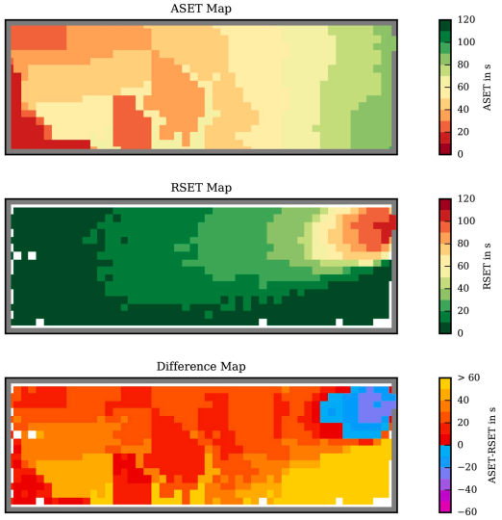
3. Research proposal
(2) Study on evacuation in tunnel fire based on ASET-RSET map.
ASET: the available safe egress time. RSET: the required safe egress time.
ASET is derived from the prediction of heat and smoke spread caused by a particular fire in a built environment, for example, the temperature, carbon monoxide concentration and visibility, which reach the limit of human tolerance. By setting the threshold of parameters for data analysis, we can get ASET map.
RSET is based on the time necessary for the people’s movement towards a place of safety. It includes fire alarm time, people's preparation time and evacuation time.
ASET-RSET map (Benjamin and Lukas)

Slide 15
3. Research proposal
(3) Study on the effect of water mist on tunnel fire control.
Effect of high-pressure water mist on fire temperature reduction and smoke disappearance.
Study on the layout distance of high-pressure water mist.
Parameter optimization studies, such as water pressure, spray coverage, etc.

Slide 16
Thank You.

